Slide 1
Bray Team Week 3 Update
Avery Haynes, Locke Lehmann, Travis Carlson, Cody Sims, Zachary Walker, Michael Hager
Week of 8/28/2023

Slide 2
Week 2 Tasks
Deliverable | Team Member | Percent Completed | Notes
Compile questions for Bray for in-person meeting | Travis | 80% | Question list is nearly complete
Logistics for traveling to Bray 9/8 | Zack | 100% | Day set, need time and travel arrangements
Complete technical question assignment to help with answering SNPS and update with new leakage deliverable | Avery | 100% | The whole team will work on the assignment, we already have it mostly done but we need to update it and complete it after our 8/28 meeting.
Research Ball Valves and share with team | Cody | 50% | On-going research, compiling shareable notes
Research Butterfly Valves and share with team | Locke | 80% | finished cross sectional area should move to focus on embedded sensors.
Setup weekly meetings and update team deliverables. | Michael | 30% | Day and time set for weekly meetings. Updating deliverables after team update.

Slide 3
Week 3 Plans
Deliverable | Team Member | Percent Completed | Notes
Write individual DR1 reports | All | 0% | Need to write individual DR1 reports, due on Monday 9/11
Research embedded valve sensors for ball valve | Cody | 0% | Complete ball valve research, start research on sensors
Research embedded valve sensors for butterfly valve | Locke | 0% | completed the cross sectional area, need to focus on sensors.
Visit Bray campus in Houston on 9/8 | All | 0% | Will drive down after classes on 9/8, around 1 PM

Slide 4
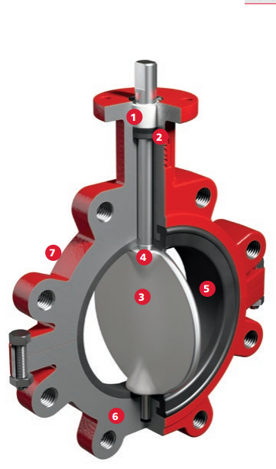
Butterfly Valve Research
STEM BUSHING: Non-corrosive, heavy duty acetal bushing absorbs actuator side thrust
STEM SEAL: Double “U” cup seal design is self-adjusting and gives positive sealing in both directions
DISC/STEM: One piece design. The disc edge is spherically machined and hand polished to produce a bubble tight shutoff, minimum torque, and longer seat life
PRIMARY AND SECONDARY SEALS: These seals prevent line media from coming in contact with the stem or body. Primary seal is achieved by an interference fit of the molded seat flat with the disc hub. Secondary seal is created because the stem diameter is greater than the diameter of the seat stem hole.
SEAT: Bray’s tongue and groove seat design provides complete isolation of flowing media from the body. The seat also features a molded o-ring which eliminates the need of flange gaskets.
BODY: Two piece wafer or lug style allows for ease of assembly and maintenance.
BODY COATINGS: For excellent corrosion resistance, Nylon 11 coating is standard for 1”- 8” valves

Slide 5
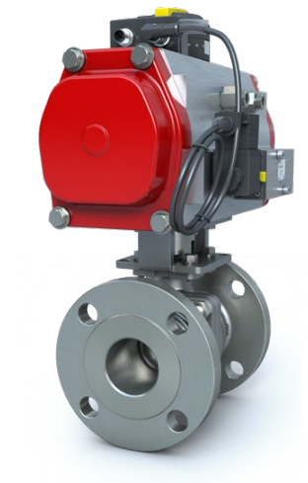
Ball Valve Research - F15/F30
Ball | Balls are precision machined and mirror finished for bubble-tight shut off and less operating torque. As an added safety feature, a hole in the stem slot of each ball equalizes pressure between the body cavity and the line media flow
Body/Endcap | 1/2"-4" (DN15-DN100) valve bodies are investment cast and solution annealed/ normalized for the highest quality and added strength. All body castings are marked with a foundry heat number for full traceability. Carbon steel bodies are phosphate coated for increased corrosion resistance.
Secure Mount | Flanged Series valves offer ease of automation due to an integrally cast actuator mounting pad which complies with ISO 5211 through 2" (DN50) sizes
Seat | The seat design ensures bi-directional, bubbletight sealing with low operating torque. All resilient seats feature relief slots or seat O.D. clearance to relieve pressure past the upstream seat. The seats are preloaded between the ball and body during assembly to ensure sealing against low-pressure and vacuum service

Slide 6
Week 3 Issues/Needs
Need more specification information on valves and actuators - should receive on in-person visit 9/8
Discuss logistics of added leakage deliverable with Bray during 9/8 visit
Majority of group working on Design Report 1 this week, focus will shift to group design work after Monday

